Slide 1

Parallel Programming in C with MPI and OpenMP
Michael J. Quinn

Slide 2
Chapter 8
Matrix-vector Multiplication

Slide 3
Chapter Objectives
Review matrix-vector multiplication
Propose replication of vectors
Develop three parallel programs, each based on a different data decomposition

Slide 4
Outline
Sequential algorithm and its complexity
Design, analysis, and implementation of three parallel programs
  Rowwise block striped
  Columnwise block striped
  Checkerboard block

Slide 5
Sequential Algorithm
2
2
2
1
1
1
0
0
0
4
4
4
1
1
1
1
1
1
1
1
1
2
5
5
9
9
3
3
3
2
2
2
1
1
1
1
1
1
3
3
3
3
3
3
3
3
3
3
9
13
14
14
×
=
4
4
4
3
3
3
1
1
1
2
2
2
4
4
4
4
4
4
4
4
4
4
13
17
19
19
3
3
3
0
0
0
2
2
2
0
0
0
1
1
1
1
1
1
1
1
1
3
3
11
11
11

Slide 6
Storing Vectors
Divide vector elements among processes
Replicate vector elements
Vector replication acceptable because vectors have only n elements, versus n² elements in matrices

Slide 7
Rowwise Block Striped Matrix
Partitioning through domain decomposition
Primitive task associated with
  Row of matrix
  Entire vector

Slide 8
Phases of Parallel Algorithm
b
Inner product computation
Row i of A
b
Row i of A
c_{i}
b
c
Row i of A
All-gather communication

Slide 9
Agglomeration and Mapping
Static number of tasks
Regular communication pattern (all-gather)
Computation time per task is constant
Strategy:
  Agglomerate groups of rows
  Create one task per MPI process

Slide 10
Complexity Analysis
Sequential algorithm complexity: Θ(n²)
Parallel algorithm computational complexity: Θ(n²/p)
Communication complexity of all-gather: Θ(log p + n)
Overall complexity: Θ(n²/p + n + log p)

Slide 11
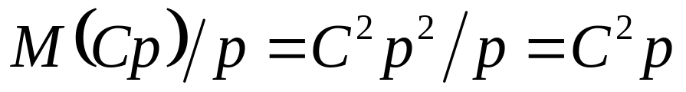
Isoefficiency Analysis
Sequential time complexity: Θ(n²)
Only parallel overhead is all-gather
  When n is large, message transmission time dominates message latency
  Parallel communication time: Θ(n)
n² ≥ Cpn ⇒ n ≥ Cp and M(n) = n²
System is not highly scalable

Slide 12
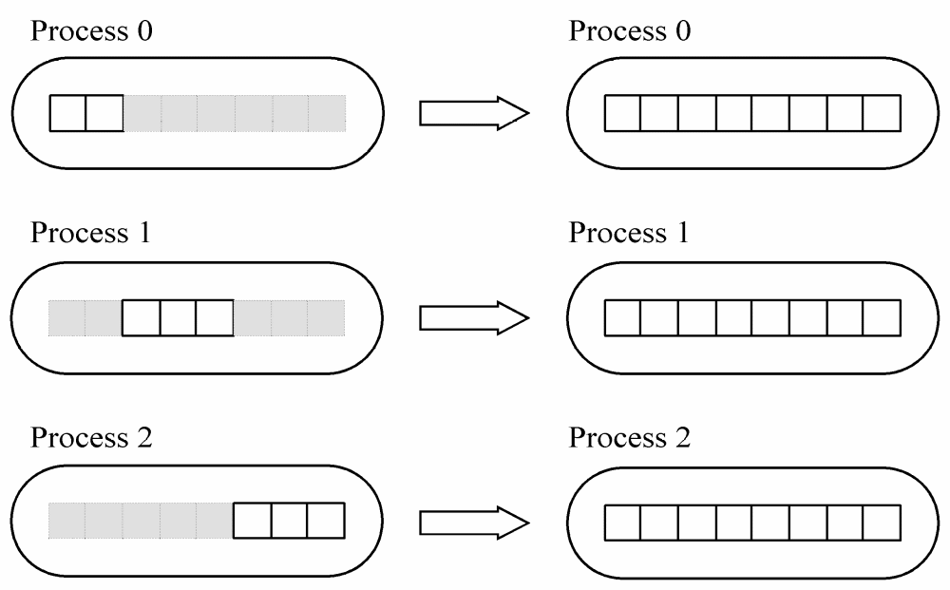
Block-to-replicated Transformation

Slide 13
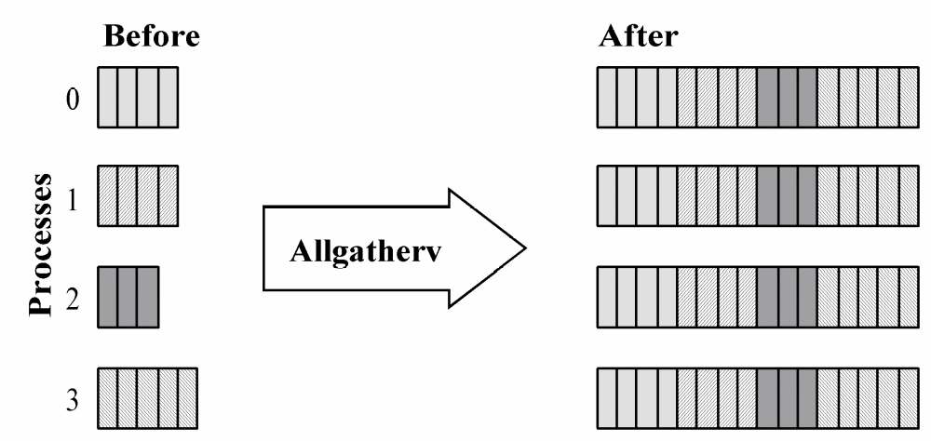
MPI_Allgatherv

Slide 14
MPI_Allgatherv
int MPI_Allgatherv (
void *send_buffer,
int send_cnt,
MPI_Datatype send_type,
void *receive_buffer,
int *receive_cnt,
int *receive_disp,
MPI_Datatype receive_type,
MPI_Comm communicator
)

Slide 15
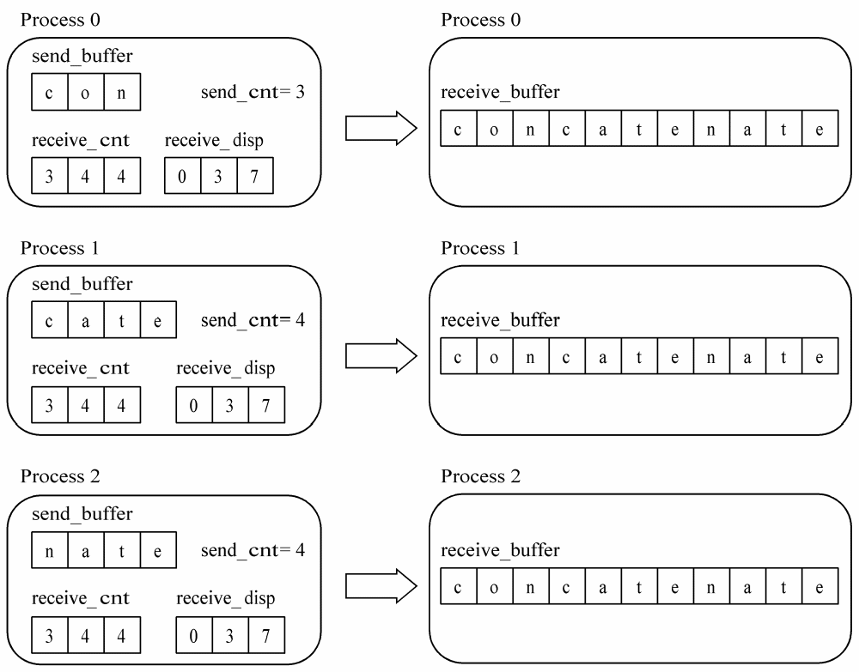
MPI_Allgatherv in Action

Slide 16
Function create_mixed_xfer_arrays
First array
  How many elements contributed by each process
  Uses utility macro BLOCK_SIZE
Second array
  Starting position of each process’ block
  Assume blocks in process rank order

Slide 17
Function replicate_block_vector
Create space for entire vector
Create “mixed transfer” arrays
Call MPI_Allgatherv

Slide 18
Function read_replicated_vector
Process p – 1
  Opens file
  Reads vector length
Broadcast vector length (root process = p – 1)
Allocate space for vector
Process p – 1 reads vector, closes file
Broadcast vector

Slide 19
Function print_replicated_vector
Process 0 prints vector
Exact call to printf depends on value of parameter datatype

Slide 20
Run-time Expression
χ: inner product loop iteration time
Computational time: χ n⎡n/p⎤
All-gather requires ⎡log p⎤ messages with latency λ
Total vector elements transmitted:
(2^{⎡log p⎤} – 1) / 2^{⎡log p⎤} (recall (p – 1)/p )
Total execution time:
χ n⎡n/p⎤ + λ⎡log p⎤ + (2^{⎡log p⎤} – 1) / (2^{⎡log p⎤} β)

Slide 21
Benchmarking Results
 | Execution Time (msec)
p | Predicted | Actual | Speedup | Mflops
1 | 63.4 | 63.4 | 1.00 | 31.6
2 | 32.4 | 32.7 | 1.94 | 61.2
3 | 22.3 | 22.7 | 2.79 | 88.1
4 | 17.0 | 17.8 | 3.56 | 112.4
5 | 14.1 | 15.2 | 4.16 | 131.6
6 | 12.0 | 13.3 | 4.76 | 150.4
7 | 10.5 | 12.2 | 5.19 | 163.9
8 | 9.4 | 11.1 | 5.70 | 180.2
16 | 5.7 | 7.2 | 8.79 | 277.8

Slide 22
Columnwise Block Striped Matrix
Partitioning through domain decomposition
Task associated with
  Column of matrix
  Vector element

Slide 23
Matrix-Vector Multiplication
c₀ = a_{0,0} b₀ + a_{0,1} b₁ + a_{0,2} b₂ + a_{0,3} b₃ + a_{0,4} b₄
c₁ = a_{1,0} b₀ + a_{1,1} b₁ + a_{1,2} b₂ + a_{1,3} b₃ + a_{1,4} b₄
c₂ = a_{2,0} b₀ + a_{2,1} b₁ + a_{2,2} b₂ + a_{2,3} b₃ + a_{2,4} b₄
c₃ = a_{3,0} b₀ + a_{3,1} b₁ + a_{3,2} b₂ + a_{3,3} b₃ + b_{3,4} b₄
c₄ = a_{4,0} b₀ + a_{4,1} b₁ + a_{4,2} b₂ + a_{4,3} b₃ + a_{4,4} b₄
Proc 4
Proc 3
Proc 2
Processor 1’s initial computation
Processor 0’s initial computation

Slide 24
All-to-all Exchange (Before)
P0
P1
P2
P3
P4

Slide 25
All-to-all Exchange (After)
P0
P1
P2
P3
P4

Slide 26
Phases of Parallel Algorithm
Multiplications
b
b
~c
Column i of A
Column i of A
All-to-all exchange
b
c
b
~c
Column i of A
Column i of A
Reduction

Slide 27
Agglomeration and Mapping
Static number of tasks
Regular communication pattern (all-to-all)
Computation time per task is constant
Strategy:
  Agglomerate groups of columns
  Create one task per MPI process

Slide 28
Complexity Analysis
Sequential algorithm complexity: Θ(n²)
Parallel algorithm computational complexity: Θ(n²/p)
Communication complexity of all-to-all:
  Θ(n log p) or Θ(p + n)
Overall complexity:
  Θ(n²/p + n log p) or Θ(n²/p + p + n)

Slide 29
Isoefficiency Analysis
Sequential time complexity: Θ(n²)
Only parallel overhead is all-to-all
  When n is large, message transmission time dominates message latency
  Parallel communication time: Θ(n)
n² ≥ Cpn ⇒ n ≥ Cp
Scalability function same as rowwise algorithm: C²p

Slide 30
Reading a Block-Column Matrix
File

Slide 31
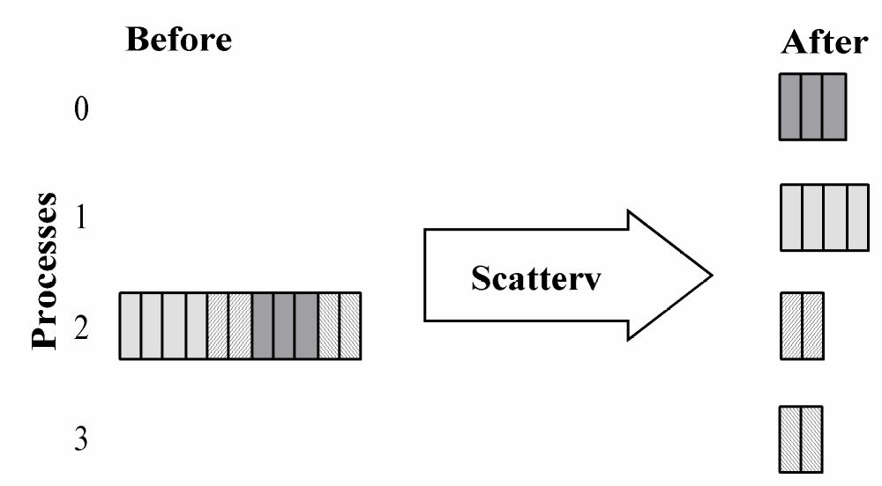
MPI_Scatterv

Slide 32
Header for MPI_Scatterv
int MPI_Scatterv (
void *send_buffer,
int *send_cnt,
int *send_disp,
MPI_Datatype send_type,
void *receive_buffer,
int receive_cnt,
MPI_Datatype receive_type,
int root,
MPI_Comm communicator
)

Slide 33
Printing a Block-Column Matrix
Data motion opposite to that we did when reading the matrix
Replace “scatter” with “gather”
Use “v” variant because different processes contribute different numbers of elements

Slide 34
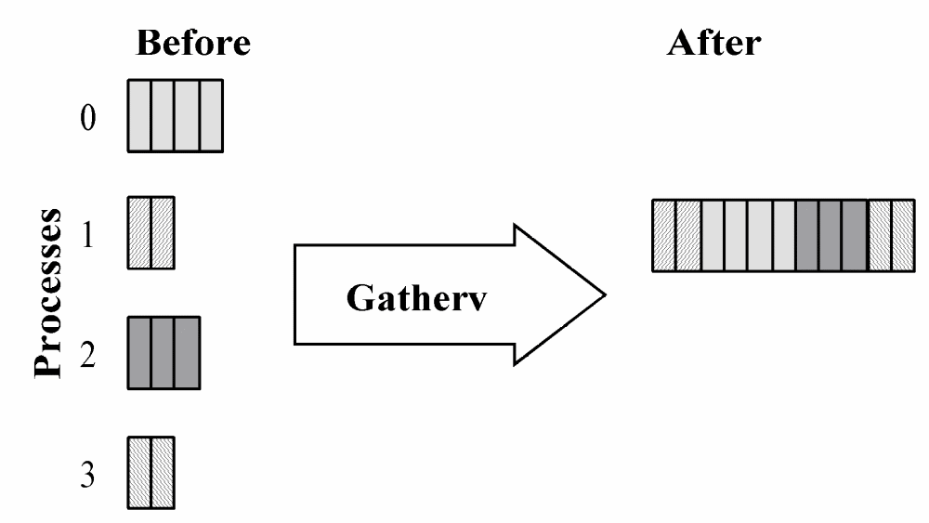
Function MPI_Gatherv

Slide 35
Header for MPI_Gatherv
int MPI_Gatherv (
void *send_buffer,
int send_cnt,
MPI_Datatype send_type,
void *receive_buffer,
int *receive_cnt,
int *receive_disp,
MPI_Datatype receive_type,
int root,
MPI_Comm communicator
)

Slide 36
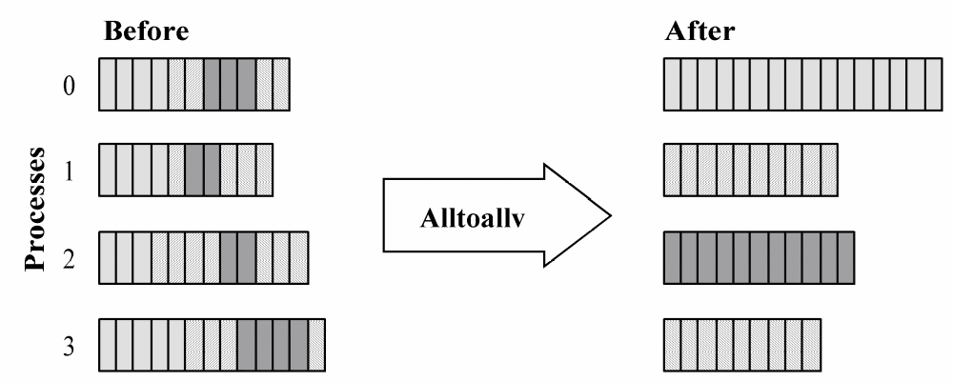
Function MPI_Alltoallv

Slide 37
Header for MPI_Alltoallv
int MPI_Alltoallv (
void *send_buffer,
int *send_cnt,
int *send_disp,
MPI_Datatype send_type,
void *receive_buffer,
int *receive_cnt,
int *receive_disp,
MPI_Datatype receive_type,
MPI_Comm communicator
)

Slide 38
Count/Displacement Arrays
MPI_Alltoallv requires two pairs of count/displacement arrays
First pair for values being sent
  send_cnt: number of elements
  send_disp: index of first element
Second pair for values being received
  recv_cnt: number of elements
  recv_disp: index of first element
create_mixed_xfer_arrays
builds these

Slide 39
Function create_uniform_xfer_arrays
First array
  How many elements received from each process (always same value)
  Uses ID and utility macro block_size
Second array
  Starting position of each process’ block
  Assume blocks in process rank order

Slide 40
Run-time Expression
χ: inner product loop iteration time
Computational time: χ n⎡n/p⎤
All-gather requires p – 1 messages, each of length about n/p
8 bytes per element
Total execution time:
χ n⎡n/p⎤ + (p – 1)(λ + 8n/(pβ))

Slide 41
Benchmarking Results
 | Execution Time (msec)
p | Predicted | Actual | Speedup | Mflops
1 | 63.4 | 63.8 | 1.00 | 31.4
2 | 32.4 | 32.9 | 1.92 | 60.8
3 | 22.2 | 22.6 | 2.80 | 88.5
4 | 17.2 | 17.5 | 3.62 | 114.3
5 | 14.3 | 14.5 | 4.37 | 137.9
6 | 12.5 | 12.6 | 5.02 | 158.7
7 | 11.3 | 11.2 | 5.65 | 178.6
8 | 10.4 | 10.0 | 6.33 | 200.0
16 | 8.5 | 7.6 | 8.33 | 263.2

Slide 42
Checkerboard Block Decomposition
Associate primitive task with each element of the matrix A
Each primitive task performs one multiply
Agglomerate primitive tasks into rectangular blocks
Processes form a 2-D grid
Vector b distributed by blocks among processes in first column of grid

Slide 43
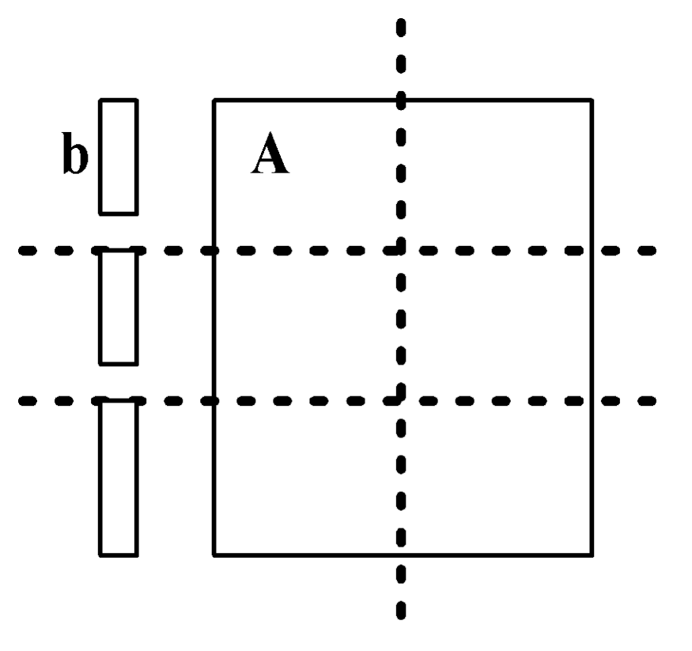
Tasks after Agglomeration

Slide 44
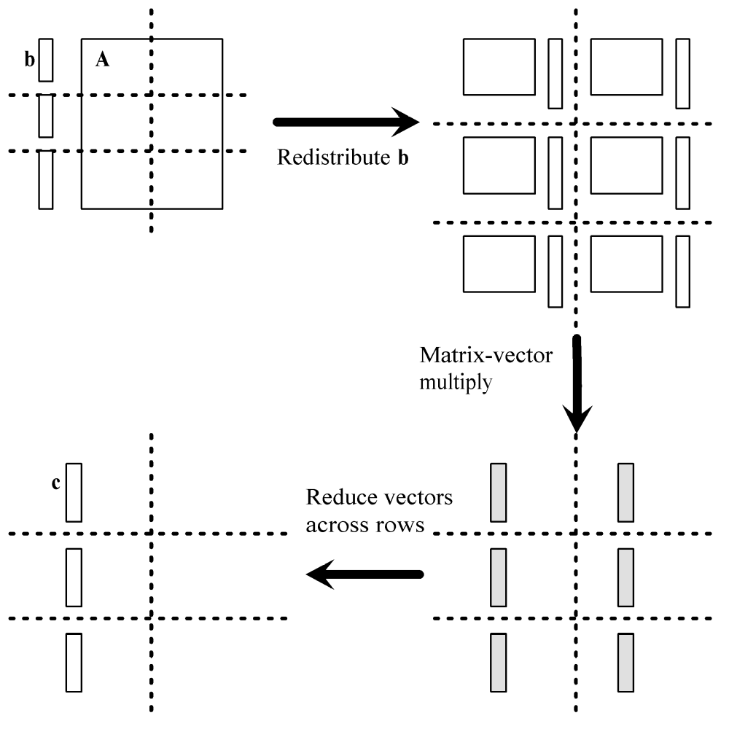
Algorithm’s Phases

Slide 45
Redistributing Vector b
Step 1: Move b from processes in first column to processes in first row
  If p square
    First column/first row processes send/receive portions of b
  If p not square
    Gather b on process 0, 0
    Process 0, 0 scatter to first row procs
Step 2: First row processes broadcast b within columns

Slide 46
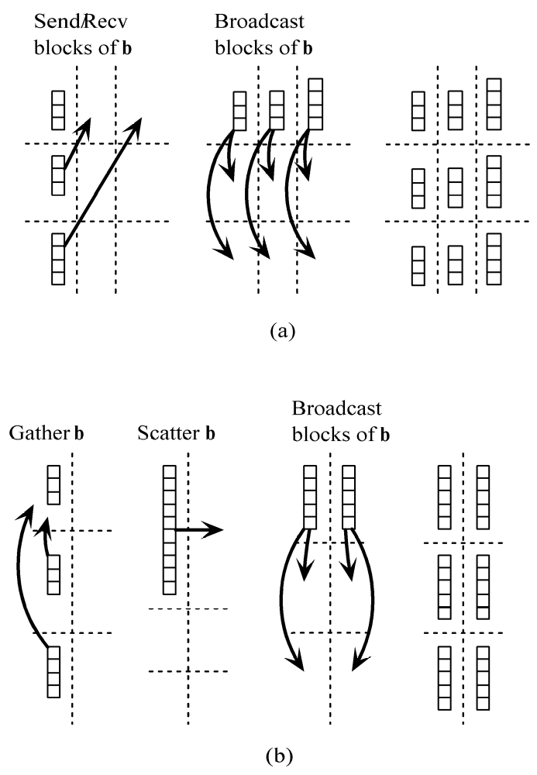
Redistributing Vector b
When p is a square number
When p is not a square number

Slide 47
Complexity Analysis
Assume p is a square number
  If grid is 1 × p, devolves into columnwise block striped
  If grid is p × 1, devolves into rowwise block striped

Slide 48
Complexity Analysis (continued)
Each process does its share of computation: Θ(n²/p)
Redistribute b:
Θ(n / √p + log √p(n / √p )) = Θ(n log p / √p)
Reduction of partial results vectors:
Θ(n log p / √p)
Overall parallel complexity:
Θ(n²/p + n log p / √p)

Slide 49
Isoefficiency Analysis
Sequential complexity: Θ(n²)
Parallel communication complexity:
Θ(n log p / √p)
Isoefficiency function:
n² ≥ Cn √p log p ⇒ n ≥ C √p log p
This system is much more scalable than the previous two implementations

Slide 50
Creating Communicators
Want processes in a virtual 2-D grid
Create a custom communicator to do this
Collective communications involve all processes in a communicator
We need to do broadcasts, reductions among subsets of processes
We will create communicators for processes in same row or same column

Slide 51
What’s in a Communicator?
Process group
Context
Attributes
  Topology (lets us address processes another way)
  Others we won’t consider

Slide 52
Creating 2-D Virtual Grid of Processes
MPI_Dims_create
  Input parameters
    Total number of processes in desired grid
    Number of grid dimensions
  Returns number of processes in each dim
MPI_Cart_create
  Creates communicator with Cartesian topology

Slide 53
MPI_Dims_create
int MPI_Dims_create (
int nodes, /* Input - Procs in grid*/
int dims, /* Input - Number of dims*/
int *size /* Input/Output – Size of
each grid dimension*/
)

Slide 54
MPI_Cart_create
int MPI_Cart_create (
MPI_Comm old_comm, /* Input - old communicator */
int dims, /* Input - grid dimensions */
int *size, /* Input - # procs in each dim */
int *periodic,
/* Input - periodic[j] is 1 if dimension j
wraps around; 0 otherwise */
int reorder,
/* 1 if process ranks can be reordered */
MPI_Comm *cart_comm
/* Output - new communicator */
)

Slide 55
Using MPI_Dims_create and MPI_Cart_create
MPI_Comm cart_comm;
int p;
int periodic[2];
int size[2];
...
size[0] = size[1] = 0;
MPI_Dims_create(p, 2, size);
periodic[0] = periodic[1] = 0;
MPI_Cart_create(MPI_COMM_WORLD, 2, size, periodic, 1, &cart_comm);

Slide 56
Useful Grid-related Functions
MPI_Cart_rank
  Given coordinates of process in Cartesian communicator, returns process rank
MPI_Cart_coords
  Given rank of process in Cartesian communicator, returns process’ coordinates

Slide 57
Header for MPI_Cart_rank
int MPI_Cart_rank (
MPI_Comm comm,
/* In - Communicator */
int *coords,
/* In - Array containing process’
grid location */
int *rank
/* Out - Rank of process at
specified coords */
)

Slide 58
Header for MPI_Cart_coords
int MPI_Cart_coords (
MPI_Comm comm,
/* In – Communicator */
int rank,
/* In - Rank of process */
int dims,
/* In - Dimensions in virtual grid */
int *coords
/* Out - Coordinates of specified
process in virtual grid */
)

Slide 59
MPI_Comm_split
Partitions the processes of a communicator into one or more subgroups
Constructs a communicator for each subgroup
Allows processes in each subgroup to perform their own collective communications
Needed for columnwise scatter and rowwise reduce

Slide 60
Header for MPI_Comm_split
int MPI_Comm_split (
MPI_Comm old_comm,
/* In - Existing communicator */
int partition, /* In - Partition number */
int new_rank,
/* In - Ranking order of processes
in new communicator */
MPI_Comm *new_comm
/* Out - New communicator shared by
processes in same partition */
)

Slide 61
Example: Create Communicators for Process Rows
MPI_Comm grid_comm;
/* 2-D process grid */
MPI_Comm grid_coords[2];
/* Location of process in grid */
MPI_Comm row_comm;
/* Processes in same row */
MPI_Comm_split (grid_comm, grid_coords[0],
grid_coords[1], &row_comm);

Slide 62
Run-time Expression
Computational time: χ ⎡n/√p⎤ ⎡n/√p⎤
Suppose p a square number
Redistribute b
  Send/Recv: λ + 8 ⎡n/√p⎤ / β
  Broadcast: log √p ( λ + 8 ⎡n/√p⎤ / β)
Reduce partial results:
log √p ( λ + 8 ⎡n/√p⎤ / β)

Slide 63
Benchmarking
Procs | Predicted(msec) | Actual (msec) | Speedup | Megaflops
1 | 63.4 | 63.4 | 1.00 | 31.6
4 | 17.8 | 17.4 | 3.64 | 114.9
9 | 9.7 | 9.7 | 6.53 | 206.2
16 | 6.2 | 6.2 | 10.21 | 322.6

Slide 64
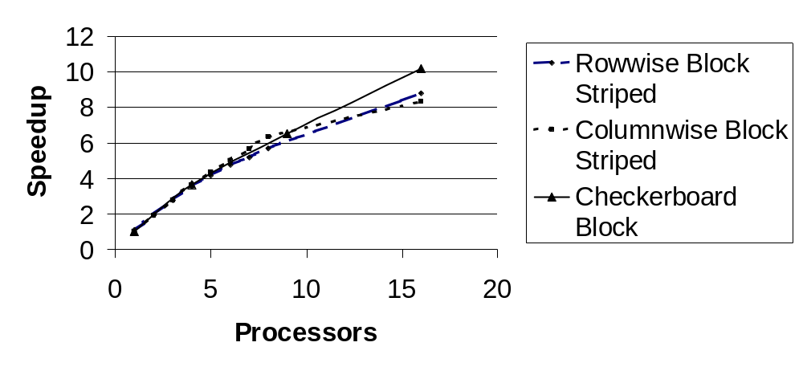
Comparison of Three Algorithms

Slide 65
Summary (1/3)
Matrix decomposition ⇒ communications needed
  Rowwise block striped: all-gather
  Columnwise block striped: all-to-all exchange
  Checkerboard block: gather, scatter, broadcast, reduce
All three algorithms: roughly same number of messages
Elements transmitted per process varies
  First two algorithms: Θ(n) elements per process
  Checkerboard algorithm: Θ(n/√p) elements
Checkerboard block algorithm has better scalability

Slide 66
Summary (2/3)
Communicators with Cartesian topology
  Creation
  Identifying processes by rank or coords
Subdividing communicators
  Allows collective operations among subsets of processes

Slide 67
Summary (3/3)
Parallel programs and supporting functions much longer than C counterparts
Extra code devoted to reading, distributing, printing matrices and vectors
Developing and debugging these functions is tedious and difficult
Makes sense to generalize functions and put them in libraries for reuse

Slide 68
MPI Application Development
Application
C and Standard Libraries
Application-specific Library
MPI Library

